Slide 1
ECE4560 – Introduction to Automation and Robotics
Lie Groups: Quick Intro to Matrix Versions
Patricio A. Vela

Slide 2
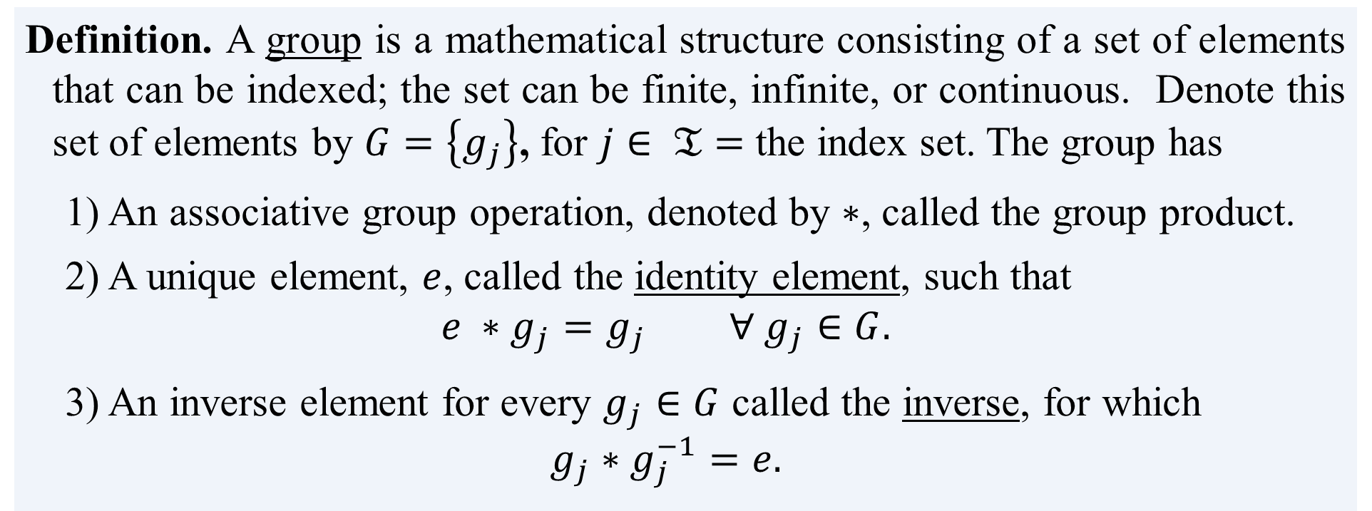
What is a group?
Definition. A group is a mathematical structure consisting of a set of elements that can be indexed; the set can be finite, infinite, or continuous. Denote this set of elements by $G=\left\{g_{j}\right\}$, for $j∈ 𝔗=$ the index set. The group has
1) An associative group operation, denoted by $∗$, called the group product.
2) A unique element, $e$, called the identity element, such that
$$e ∗g_{j}=g_{j} ∀ g_{j}∈G.$$
3) An inverse element for every $g_{j}∈G$ called the inverse, for which
$$g_{j}∗g_{j}^{−1}=e.$$

Slide 3
What is a Lie group?
Definition. A Lie group is a group $G$ which is also a smooth manifold and for which the group product and inverse are smooth.
OK, but what …
is smooth?
is a manifold?

Slide 4
Example: Rotation matrices (i.e., Orthogonal matrices)
Definition. The Lie group $O\left(2\right)$ consists of the set of orthogonal 2x2 matrices. It is called the orthogonal group in 2-space.
$R∈SO(2)$ can be represented by $R=\left[\begin{matrix}a & −b \\ b & a\end{matrix}\right]$, such that $R^{T}R=1$
Definition. The Lie group $SO\left(2\right)$ consists of the set of orthogonal 2x2 matrices with unit determinant. It is called the special rthogonal group in 2-space.
$SO\left(2\right)⊂O(2)$ such that it comprises of $R∈O(2)$ and $\det\left(R\right)=+1.$

Slide 5
Example: Rotation matrices (i.e., Orthogonal matrices)
Definition. The Lie group $O\left(3\right)$ consists of the set of orthogonal 3x3 matrices. It is called the orthogonal group in 3-space.
Definition. The Lie group $SO\left(3\right)$ consists of the set of orthogonal 3x3 matrices with unit determinant. It is called the special orthogonal group in 3-space.
$SO\left(3\right)⊂O(3)$ such that it comprises of $R∈O(3)$ and $\det\left(R\right)=+1.$

Slide 6
Example: Rotation matrices (i.e., Orthogonal matrices)
Definition. The Lie group $𝔼\left(2\right)$ consists of the set of 2D translations. It is called Euclidean 2-space.
$t∈𝔼(2)$ can be represented by $t=\left[\begin{matrix}t^{1} \\ t^{2}\end{matrix}\right]$, such that $t^{i}∈ ℝ .$
Definition. The Lie group $SE\left(2\right)$ consists of the set of 2D rigid body displacements. It is called the special Euclidean group in 2-space.
$g∈SE(2)$ can be represented by $g=$ $\left[\begin{matrix}R & t \\ 0 & 1\end{matrix}\right]$,
where $R∈SO(2)$ and $t∈𝔼(2)$

Slide 7
Example: Rotation matrices (i.e., Orthogonal matrices)
Definition. The Lie group $𝔼\left(3\right)$ consists of the set of 3D translations. It is called Euclidean 3-space.
$t∈𝔼(3)$ can be represented by $t=\left[\begin{matrix}t^{1} \\ t^{2} \\ t^{3}\end{matrix}\right]$, such that $t^{i}∈ ℝ .$
Definition. The Lie group $S3\left(2\right)$ consists of the set of 2D rigid body displacements. It is called the special Euclidean group in 3-space.
$g∈SE(2)$ can be represented by $g=$ $\left[\begin{matrix}R & t \\ 0 & 1\end{matrix}\right]$,
where $R∈SO(3)$ and $t∈𝔼(3)$

Slide 8
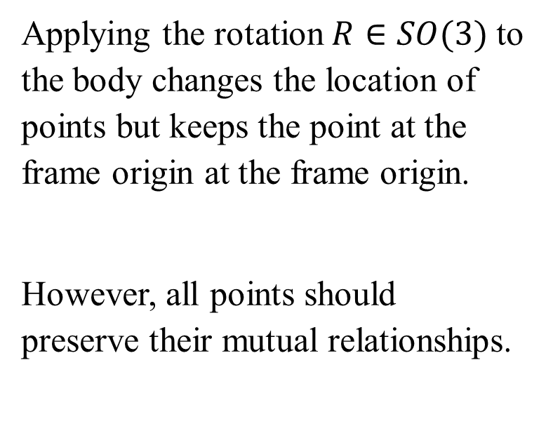
The Space $SO(3)$
Consider a 3D rigid body that is free to rotate about a fixed point in it.
Let there be a frame located at the fixed point.
Applying the rotation $R∈SO(3)$ to the body changes the location of points but keeps the point at the frame origin at the frame origin.
However, all points should preserve their mutual relationships.

