Slide 1
ECE4560 – Introduction to Automation and Robotics
Trajectory Generation with Cubic Splines
Patricio A. Vela

Slide 2
Example
GOAL: Join initial and final joint configurations with a trajectory whose velocity does not exceed $\frac{π}{4}$ radians.

Slide 3
Example
GOAL: Join initial and final joint configurations with a trajectory whose velocity does not exceed $\frac{π}{4}$ radians.
Initial guess uses distance – velocity relationship: $t_{f}=\frac{{Δα}_{max}}{v_{max}}$ which leads to $t_{f}=\frac{π}{π/4}\frac{rad}{rad/sec}=4 sec$
Equation for a single joint angle $α_{i}(t)=a_{0}^{i}+a_{1}^{i}t+a_{2}^{i}t^{2}+a_{3}^{i}t^{3}=\left[1 t t^{2}{ t}^{3}\right] \vec{a_{i}}=T\left(t\right) \vec{a_{i}}={\vec{a_{i}}}^{T}⋅\vec{T}(t)$
Equation for combination of all joint angles $α(t)=\left[\begin{matrix}{\vec{a_{1}}}^{T} \\ {\vec{a_{2}}}^{T} \\ {\vec{a_{3}}}^{T}\end{matrix} \right]⋅\vec{T}(t)=A^{T}⋅\vec{T}(t)$

Slide 4
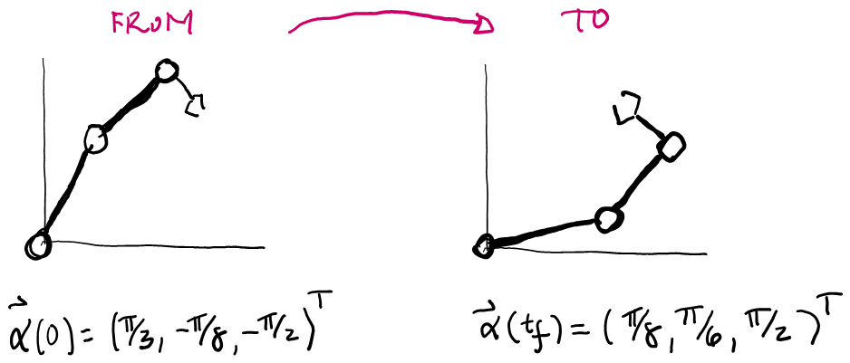
Example
GOAL: Join initial and final joint configurations with a trajectory whose velocity does not exceed $\frac{π}{4}$ radians.
Equation to solve joint angle cubic polynomials $\left[\begin{matrix}T\left(0\right) \\ T\left(t_{f}\right) \\ \begin{aligned}T_{dot}\left(0\right) \\ T_{dot}\left(t_{f}\right)\end{aligned}\end{matrix}\right]⋅A=P_{0}=\left[\begin{matrix}\vec{p_{0,1}} & \vec{p_{0,2}} & \vec{p_{0,3}}\end{matrix}\right]=\left[\begin{matrix}\frac{π}{3} & −\frac{π}{8} & −\frac{π}{2} \\ \frac{π}{8} & \frac{π}{6} & \frac{π}{2} \\ 0 & 0 & 0 \\ 0 & 0 & 0\end{matrix}\right]=P_{0}$
$T_{mat}\left(t_{f}\right)⋅A=P_{0}$
The Matlab solution code is A = Tmat \ P0
$$T_{dot}\left(t\right)=\left[\begin{matrix}0 & 1 & 2t & 3t^{2}\end{matrix}\right]$$

Slide 5
Example
GOAL: Join initial and final joint configurations with a trajectory whose velocity does not exceed $\frac{π}{4}$ radians.
The Matlab solution is $A=\left[\begin{matrix}\frac{π}{3} & 0 & −\frac{5π}{128} & \frac{5π}{768} \\ −\frac{π}{8} & 0 & \frac{7π}{128} & −\frac{7π}{768} \\ −\frac{π}{2} & 0 & \frac{3π}{16} & −\frac{π}{32}\end{matrix}\right]$
Checking the velocity using $\dot{α}\left(t\right)=A⋅{ \vec{T}}_{dot}\left(t\right)$
we find that $α_{3}\left(t\right)$ peaks at a value greater than $\frac{π}{4}\frac{rad}{sec}$.
$${\vec{T}}_{dot}\left(t\right)=\left[\begin{matrix}0 \\ 1 \\ 2t \\ 3t^{2}\end{matrix}\right]=T_{dot}^{T}(t)$$

Slide 6
Example
GOAL: Join initial and final joint configurations with a trajectory whose velocity does not exceed $\frac{π}{4}$ radians.
Resolving for $t_{f}=7$ gives $A=\left[\begin{matrix}\frac{π}{3} & 0 & −\frac{5π}{392} & \frac{5π}{4116} \\ −\frac{π}{8} & 0 & \frac{7π}{5} & −\frac{7π}{5888} \\ −\frac{π}{2} & 0 & \frac{3π}{49} & −\frac{π}{343}\end{matrix}\right]$
Whose peak joint rates don’t surpass $\frac{π}{4} \frac{rad}{sec}$.

Slide 7
Trajectories with Waypoints
Cubic Splines

Slide 8
Q: What if there are waypoints?
Bad Idea: Connect using individual cubic splines between pairwise adjacent waypoints.
$$p_{f}$$
$$p_{1}$$
$$p_{3}$$
$$p_{i}$$
$$p_{2}$$
A: Use multiple cubic polynomials
… Use splines.
Options:
Specify points and velocities
Constrain to have matching velocities

Slide 9
Cubic splines based on waypoints.
$$p_{f}=p_{n}$$
$$p_{1}$$
$$p_{3}$$
$$p_{i}=p_{0}$$
$$p_{2}$$
Involves $\left(n+1\right)$ polynomials of the form:
$p^{k}\left(t\right)=a_{0}^{k}+a_{1}^{k}\left(t\right)+a_{2}^{k}\left(t\right)+a_{3}^{k}t^{3}$
Whose complete solution is
$p\left(t\right)=p^{k}\left(t−t_{k}\right)$ for $k$ such that $t∈\left[t_{k}, t_{k+1}\right]$

Slide 10
Cubic splines based on waypoints.
$$p_{f}=p_{n}$$
$$p_{1}$$
$$p_{3}$$
$$p_{i}=p_{0}$$
$$p_{2}$$
Involves $\left(n+1\right)$ polynomials of the form:
$p^{k}\left(t\right)=a_{0}^{k}+a_{1}^{k}\left(t\right)+a_{2}^{k}\left(t\right)+a_{3}^{k}t^{3}$
Whose complete solution is
$p\left(t\right)=p^{k}\left(t−t_{k}\right)$ for $k$ such that $t∈\left[t_{k}, t_{k+1}\right]$
When intervals are equidistant, $ΔT=t_{k+1}−t_{k}$, then $k= \left\lfloor \frac{t}{T}\right\rfloor =floor\left(\frac{t}{T}\right)∈\left\{0,…,n\right\}.$

